Slide 1
EECS 2500 Linear Data Structures
Lecture 08
Chapter 03 – The Stack ADT – Part 2
Fall 2016
Dr. Larry G. Thomas – University of Toledo/LCCC

Slide 2
Chapter Outline
3.1 Stacks
3.2 Collection Elements
3.3 Exceptional Situations
3.4 Formal Specification
3.5 Application: Well-Formed Expressions
3.6 Array-based Implementation
3.7 Link-based Implementation
3.8 Case Study: Postfix Expression Evaluator

Slide 3
Last Time
Introduced the stack
Operators: push, pop, (top)
Call Stack
LIFO: Last-In-First-Out
Using collections of Objects
The need to cast when we remove from the stack
Generics
Parameterized data types (see pp. 166-167)
Exceptions
Our data structures may need to throw exceptions
Stack Specification

Slide 4
Array-Based Implementation (§3.5)
In this section we study an array-based implementation of the Stack ADT.
Additionally, a feature section (pp. 192-193) looks at an alternate implementation that uses the Java Library ArrayList class.

Slide 5
Array-Based Implementation
We use an array to store the objects on the stack
Given our nomenclature that the stack operations are all performed on the “top” of the stack, we will think of our array as being “upside-down”
We can think of the array in the usual form (with element zero on top) if we modify our definition to say that all stack operations happen on the “bottom”

Slide 6
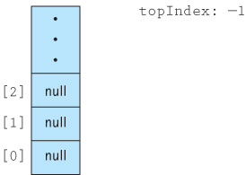
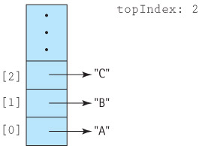
Visualizing the Stack
The empty stack:
After pushing “A”, “B” and “C”

Slide 7
Array-Based Implementation
Since we are using an array, the number of items the stack can hold is bounded by the size of the array. We need two constructors:
One (with no arguments) that sets a default size of 100
One with a size argument (the size we set it to)
We need two “status” methods:
isFull / isEmpty
We need two mutator methods:
push / pop
We need one accessor method:
top

Slide 8
The Code: Part 1 - Constructors
package ch03.stacks;
public class ArrayStack<T> implements BoundedStackInterface<T>
{
protected final int DEFCAP = 100; // DEFault CAPacity
protected T[] stack; // holds stack items
protected int topIndex = -1; // Where is stack’s top?
public ArrayStack()
{
// Constructor #1 – no arguments – use default capacity
stack = (T[]) new Object[DEFCAP];
}
public ArrayStack(int maxSize)
{
// Constructor #2 – set stack to specified size
stack = (T[]) new Object[maxSize];
}

Slide 9
Stack Operations: isFull / isEmpty
isFull and isEmpty are pretty easy.
If topIndex is -1 (as initialized), then the stack is empty
If topIndex is stack.length-1 (i.e., the last used slot is the last slot in the array), then it’s full

Slide 10
The Code: Part 2
public boolean isEmpty()
{
// Returns true if stack (totally) empty; false otherwise
if (topIndex == -1)
return true;
else
return false;
// How could we code this as a single one-line statement?
}
public boolean isFull()
{
// Returns true if the stack is full; false otherwise
if (topIndex == (stack.length – 1))
return true;
else
return false;
}

Slide 11
The Code: Part 2 - Cleaner
public boolean isEmpty()
{
// Returns true if stack (totally) empty; false otherwise
return (topIndex == -1);
}
public boolean isFull()
{
// Returns true if the stack is full; false otherwise
return (topIndex == (stack.length – 1));
}

Slide 12
Stack Operations: push
pushing onto the stack presupposes that the stack is not already full.
If it is already full when push is called, then throw a StackOverflowException
Otherwise, increment the location pointer and store the specified value in that slot

Slide 13
The Code: Part 3 - push
public void push(T element)
{
// Throws StackOverFlowException if stack is already full. Otherwise,
// places element at the top of the stack and adjusts the topIndex
// stack pointer
//
if (isFull())
throw new StackOverflowException("Push attempted on full stack");
else // the text reverses the “then” and “else” sequence
{
topIndex++; // Point at next slot
stack[topIndex] = element; // Store element there
}
} // end push
The else clause above can be replaced with:
stack[++topIndex] = element; // increment; then store

Slide 14
Stack Operations: pop
popping off the stack presupposes that the stack is not already empty.
If it is already empty when pop is called, then throw a StackUnderflowException
Otherwise, clear (“null out”) the value from the top slot and decrement the location pointer
What if we don’t clear the existing value?
It will still work, but it’s poor programming practice
When you’re through with something, get rid of it.
See Fig 3-6 (p. 189)

Slide 15
The Code: Part 4 - pop
public void pop()
{
// Throws StackUnderFlowException if stack is already empty.
// Otherwise, removes element at the top of the stack and adjusts the
// topIndex stack pointer
//
if (isEmpty())
throw new StackUnderflowException("Pop attempted on empty stack");
else
{
stack[topIndex] = null; // clear the element there
topIndex--; // Point at previous slot
}
} // end pop
The else clause above can be replaced with:
stack[topIndex--] = null; // clear; then decrement

Slide 16
Stack Operations: top
Peeking at the top entry on the stack presupposes that the stack is not empty.
If it is empty when top is called, then throw a StackUnderflowException
It it’s not empty, return the value (i.e., reference) from the top slot

Slide 17
The Code: Part 5 - top
public T top()
{
// Throws StackUnderFlowException if the stack is empty
// Otherwise, returns element at the top of the stack
//
if (isEmpty())
throw new StackUnderflowException("Top attempted on empty stack");
else
return stack[topIndex]; // return the Object @ the top
} // end top

Slide 18
Testing The Code
See the discussion and test plan on pp. 190-191
Your test plan should test example scenarios that exercise (exorcise?) all functional possibilities:
push when empty, containing 1, a few, almost full, full
pop when empty, containing 1, a few, almost full, full
push followed by pop
pop followed by push
top when stack is full, empty, contains at least 1
Start with empty stack, push, pop, test isEmpty()
Start with full stack, pop, push, test isFull()
…

Slide 19
Well-Formed Expressions (§3.6)
Now let’s use a stack in a practical application
We said that stacks are used a lot in computing to manage call / return stacks, and to parse code and expressions.
Who has ever had trouble matching braces ({})?
Let’s parse some expressions to see if they’re “valid”

Slide 20
Well-Formed Expressions
The problem: Given a set of grouping symbols (like parentheses and/or braces, determine if the open and close versions of each symbol are matched correctly. If they are, then the expression is said to be well-formed
We’ll focus on the typical pairs, (), [], and {}, but in theory we could define any pair of symbols (e.g., < > or / \) as grouping symbols.
We’re not limited to one pair – we can work with any number of pairs of symbols: (), [], {}, <>, …

Slide 21
Well-Formed Expressions
Any number of other characters may appear in the input expression, before, between, or after a grouping pair (we’ll represent such character(s) with x), and an expression may contain nested groupings.
Each “close” symbol must match the last unmatched “open” symbol and each “open” grouping symbol must have a matching “close” symbol.

Slide 22
Well-Formed Expressions: Examples
Well-Formed Expressions using (), [], and {}:
(xx(xx())xx)
[](){}
([]{xxx}xxx()xxx)
([{[(([{x}])x)]}x])
Ill-formed expressions:
(xx(xx())xxx)xxx)
][
(xx[xxx)xx]
([{[(([{x}])x)]}x})
Note: Humans parse or “validate” such expressions visually, using the complicated eye / brain system; we “seek out” the innermost expression and then work our way out.
The computer can’t work that way; it must start at one end (usually the front end) and work one character at a time to the other end
A Stack makes this possible

Slide 23
The Balanced Class
To help solve our problem we create a class called Balanced, with two instance variables of type String (openSet and closeSet) and a single exported method test
The Constructor is:
public Balanced(String openSet, String closeSet)
// Preconditions: No character is contained more than once in the combined
// openSet and closeSet strings.
// The size of openSet = the size of closeSet.
{
this.openSet = openSet;
this.closeSet = closeSet;
}

Slide 24
The test Method
Takes an expression as a String argument and checks to see if the grouping symbols in the expression are balanced.
We return an integer to indicate the result:
0: The symbols are balanced, such as (([xx])xx)
1: The expression has unbalanced symbols, such as (([xx}xx))
2: The expression came to an end prematurely, such as (([xxx])xx

Slide 25
The test Method (2)
Do (exactly) one of three things for each input character:
1. If the character is neither an open symbol nor a close symbol, skip it (the x in the previous examples)
2. If the character is an open symbol, push it onto a stack
3. If the character is a close symbol, it is checked against the last open symbol, which is taken from the top of the stack. If they (the open/close symbols) match, processing continues with the next character. If the close symbol does not match the top of the stack, or if the stack is empty, then the expression is ill-formed.

Slide 26
The Algorithm for test
Create a new (bounded) stack of size equal to the length of subject
Set stillBalanced to true
Get the first character from subject
while (the expression is still balanced AND
there are still more characters to process)
{
Process the current character (the 3 things from the last slide)
Get the next character from subject
}
if (!stillBalanced)
return 1 // imbalanced expression
else if (stack is not empty)
return 2 // unexpected end of expression
else
return 0 // expression is balanced

Slide 27
Processing the Current Character
1. If it’s neither an open nor a close character, skip it
2. If it’s an open symbol, push it on the stack
3. If it’s a close symbol, compare it with the value on top of the stack to see if it’s the matching close symbol for the last unmatched open
if (the character is an open symbol)
push the open symbol onto the stack
else if (the character is a close symbol)
if (the stack is empty)
set stillBalanced to false
else
Set open symbol character to the top of the stack
pop the stack
if (the close symbol doesn’t “match” the open symbol)
set stillBalanced to false
else
skip the character (do nothing)

Slide 28
Some Notes on the Text’s Code
1. The stack is declared to be of type BoundedStackInterface, but is instantiated as an ArrayClass (See §2.2)
2. Rather than pushing the actual open character onto the stack, we push its position on the list, and we expect the open and close lists to match up, position by position OpenList: ([{ OK ({[ not OK CloseList: )]} ])}
Example: The 2nd character on the close list matches the 2nd character on the open list, so we can push 2 on the stack, rather than the open character itself

Slide 29
Some Notes on the Text’s Code (2)
3. We said our stack would process Objects, but the integer we’re going to put on the stack is a primitive type (not an Object).
Not a problem – java auto-boxes.
Recall the Character and Integer wrapper classes we used last semester to provide character- and integer-related methods.
When a primitive is used as an Object, java automatically converts (boxes) the primitive to the appropriate Object type for us.
When we push an int to our Object-based stack, java pushes an Integer for us

Slide 30
Some Notes on the Text’s Code (3)
4. Java also unboxes. We can use:
openIndex =(Integer)stack.top();
rather than having to use:
openIndex =((Integer)stack.top()).intValue();

Slide 31
Some Notes on the Text’s Code (4)
5. When we access the stack to get the close symbol, we can either use isEmpty(), to see if the stack is empty, or we can just attempt the access and let a StackUnderflow exception occur (and handle it). The text goes with the latter approach, to illustrate how to use the exception handling mechanism
6. When test is about to return its result code, it uses isEmpty(). Because it’s not trying to access data on the stack, this is the appropriate approach

Slide 32
The Code
See handout sheets and pp. 198-200
I have made minor changes to the style of the code and the comments.
You are expected to follow my style in this class
The Balanced class handles checking expressions; we just need a program to get some expressions and see how it does.
BalancedApp is an interactive program to prompt the user for expressions and see if they’re balanced. It uses ([{ and )]}.
Handout with BalancedApp code

Slide 33
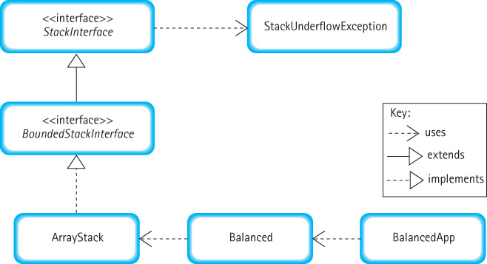
BalancedApp Architecture

Slide 34
Link-Based Implementation (§3.7)
Recall from Chapter 2:
To create a linked list, we need a self-referential class for the node objects
Each node contains some data (an Object for our Object-storing stack) and a link (or reference or pointer) to the next node in the list
We need a constructor, and get/set methods for the data (the Object) and the link
Rather than LLStringNode, we have LLNode<T>

Slide 35
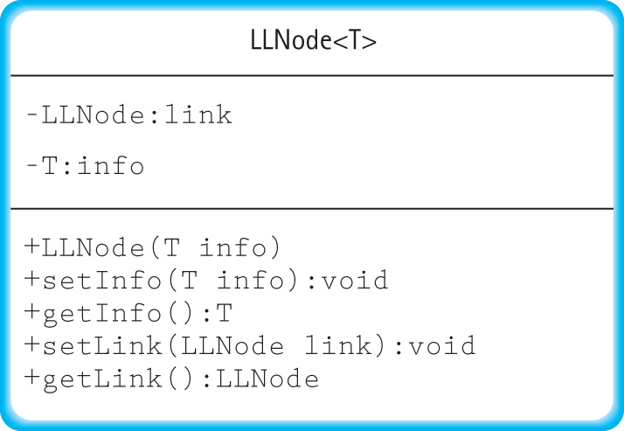
Link-Based Implementation

Slide 36
The Code
//----------------------------------------
// LLObjectNode.java by Dale / Joyce / Weems / Thomas
//
// Implements nodes of type <T> for a Linked List.
//----------------------------------------
package support;
public class LLNode<T>
{
private LLNode link;
private T info;
public LLNode(T info)
{
this.info = info;
link = null;
}
...
...
public void setInfo(T info)
{
this.info = info;
}
public T getInfo()
{
return info;
}
public void setLink(LLNode link)
{
this.link = link;
}
public LLNode getLink()
{
return link;
}
} // end class

Slide 37
Link-Based Stack Implementation
We need a variable (top) to refer to the top node of the stack (the top node will refer to the second node, which will refer to the third, …).
Our constructor needs to initialize the stack to be empty (top is null)

Slide 38
The Code: Part 1 - Constructor
//-------------------------------------------------------------------
// LinkedStack.java by Dale/Joyce/Weems Chapter 3
//
// Implements UnboundedStackInterface using a linked list to hold the stack elements
//-------------------------------------------------------------------
import support.LLObjectNode;
public class LinkedStack<T> implements UnboundedStackInterface<T>
{
protected LLNode<T> top; // reference to the top of this stack
public LinkedStack()
{
// constructor – there’s no data to fill in; just make the stack
// be empty be ensuring that the top reference refers to nothing
//
top = null;
}

Slide 39
Stack Operations: push
Pushing an item onto the stack means that it becomes the topmost item in the stack.
In our Object-storing stack, we create a new node to hold the object we’re putting on the stack
Since we have a reference variable called top, and our new node needs to be on top of the stack, when we’re finished, top should point at our new node.

Slide 40
Stack Operations: push
Start w/empty stack:
push “A”:
Then push “B”:
Then push “C”:
(1) Create new node to hold info. (2) Make new node point where top currently does. (3) Make top point to new node
top
null
top
A null
top
B
A null
top
C
B
A null

Slide 41
Stack Operations: pop
If stack empty, there’s no node to pop: Exception!
If list has one node, pop():
If list has more than one node, pop():
(1) If stack empty, throw underflow exception. (2) Make top point to what the first node currently points to
top
null
top
A null
top
null
top
B
A null
top
A null

Slide 42
The Code: Part 2 – push / pop
public void push(T element)
{
// Put a new Object on the top of the stack:
// (1) Create new node to hold info.
// (2) Make new node point where top used to.
// (3) Make top point to new node
//
LLNode<T> newNode = new LLNode<T>(element); // (1)
newNode.setLink(top); // (2)
top = newNode; // (3)
}
public void pop()
{
// If stack not empty, removes the object from the top of the stack
// If stack IS empty, throws StackUnderflowException
//
// (1) If stack empty, throw underflow exception. // (2) Make top point to what the first node currently points to
//
if (isEmpty()) throw new StackUnderflowException(“Attempt to pop empty stack”); //(1)
else top = top.getLink(); //(2)
}

Slide 43
Stack Operations: top / isEmpty
top:
If stack empty, there’s no node to get - Exception!
If stack not empty, return topmost object
isEmpty:
If top is null, then the stack is empty
If top is not null, then the stack is not empty

Slide 44
The Code: Part 3 – top / isEmpty
public T top()
{
// If stack is NOT empty, returns the object from the top of the
// stack. If stack IS empty, throws StackUnderflowException
//
if (isEmpty())
throw new StackUnderflowException(“Attempted top() on empty stack”);
else
return top.getInfo();
}
public boolean isEmpty()
{
// returns true if the stack is empty; false if it is not empty
//
return (top == null);
}

Slide 45
Comparing Stack Implementations
Storage Size
Array-based: takes the same amount of memory, no matter how many array slots are actually used, proportional to maximum size
Link-based: takes space proportional to actual size of the stack (but each element requires more space than with array approach)
Operation efficiency
All operations, for each approach, are O(1)
Except for the Constructors:
Array-based: O(N)
Link-based: O(1)

Slide 46
So, Which Is Better?
The linked implementation does not have space limitations, and in applications where the number of stack elements can vary greatly, it wastes less space when the stack is small.
The array-based implementation is short, simple, and efficient. Its operations have less overhead. When the maximum size is small and we know the maximum size with certainty, the array-based implementation is a good choice

Slide 47
Case Study: Postfix Expressions (§3.8)
Consider this expression:
2 + 14 × 23
Because of the rules of operator precedence, we know that 14 will be multiplied by 23 first
If we wanted to add the 2 and the 14 first, we would have to override the precedence rules with parentheses:
(2 + 14) × 23
In the absence of precedence rules, there can be ambiguity in evaluating expressions. Parentheses are required to resolve the ambiguities

Slide 48
Case Study: Postfix Expressions (§3.8)
But, there is a way to have unambiguous expression evaluation without parentheses!
Consider the + and × operators.
They are binary operators – they operate on two pieces of information to produce one result
Our standard notation is known as infix – the operator is written between the two operands (the data on which the operator operates)
2 + 14 – or – 5 × 23

Slide 49
Case Study: Postfix Expressions (§3.8)
What if we came up with a way of using binary operators in a postfix notation? :
2 3 + add 2 and 3
5 17 × multiply 5 and 17

Slide 50
Case Study: Postfix Expressions (§3.8)
We have also seen unary (as opposed to binary) operators:
-X ++X J--
By definition, unary operators must either precede or follow their (one) operand
If the operator comes before the operand, it’s prefix notation; if the operator follows the operand it’s postfix notation

Slide 51
Case Study: Postfix Expressions (§3.8)
In postfix notation, we can do multiple operations sequentially:
6 2 + 5 × Add 6 & 2. Multiply that by 5
Using Postfix notation, expressions are evaluated left-to-right, and there are no precedence rules to remember (and parentheses are not needed!):
Infix Notation Postfix Notation
2 + 14 × 23 2 14 23 × +
(2 + 14) × 23 2 14 + 23 ×

Slide 52
Case Study: Postfix Expressions (§3.8)
So, rather than + meaning “add the value before the operator with the value after it, and replace the two operands and the operator with the result”, in Postfix notation, + means “add the last two values together, and replace those two (and the operator) with the result”
2 6 + 3 + 4 × 2 6 + → 8
8 3 + 4 × 8 3 + → 11
11 4 × 11 4 × → 44

Slide 53
Case Study: Postfix Expressions (§3.8)
We don’t have to start with two operands followed by a binary operator:
(2 + (6 + 4)) × 4) × 4)
4 2 6 4 + + 4 × × 6 4 + → 10
4 2 10 + 4 × × 2 10 + → 12
4 12 4 × × 12 4 × → 48
4 48 × 4 48 × → 192
This postfix operation notation is known as RPN: Reverse Polish Notation (no, this is not an ethnic slur – see this article)

Slide 54
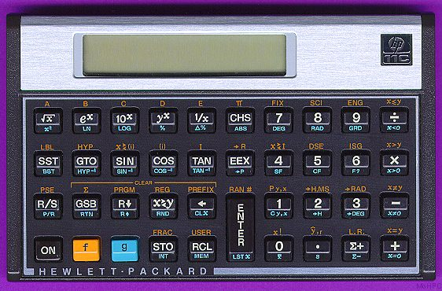
Case Study: Postfix Expressions (§3.8)
This surely can’t have any practical application!
What’s missing from this calculator?

Slide 55
Case Study: Postfix Expressions (§3.8)
HP has been producing RPN calculators for decades.
They don’t need an equals button (=), because operations are performed as soon as the operator is seen, just as we’ve been doing it.
Moreover, the compiler that reads your source code will convert infix (algebraic) notation into postfix sequence for execution.
Great, this is a nice academic exercise, and someone has done a commercial implementation, but what does it have to do with linear data structures?
RPN is done without parentheses, but with a stack!

Slide 56
RPN and the Stack
Evaluating an expression:
Assume our input is broken into “tokens”
Tokens can either be values or operators
Read the expression left-to-right. For the current token, …
…If it’s a value, push it onto the stack
…If it’s an operator, get the two values from the top of the stack (top/pop, top/pop), perform the operation on the two values, and push the result back on the stack

Slide 57
RPN and the Stack
A little more detail:
while (more tokens exist)
get a token
if (token is an operand)
stack.push(token)
else
operand2 = stack.top(); stack.pop();
operand1 = stack.top(); stack.pop();
stack.push(operand1 <?> operand2);
result = stack.top;
stack.pop();
return result;

Slide 58
The HP Calculator Again
The big ENTER button:
Pushes the value on the display onto the stack!

Slide 59
RPN and the Stack
What about errors?
4 4 + is OK, but what about:
4 4 + + too many operators / few operands
4 4 4 + too many operands / few operators
How can we tell which kind of error we have?
An expression has too few operands if…
…we hit an operator and there aren’t at least two operands on the stack
An expression has too many operands if…
…we finish evaluating the expression and we have more than one value left on the stack

Slide 60
A More Detailed Algorithm
while (there are input items left)
read the next item from input
if (the item is a value)
push the value
else //the item is an operator
if (there are < 2 values on the stack)
(Error) Too Few Operands.
else
top/pop 2 values from the stack.
evaluate the operator, with the values as operands.
push the result back onto the stack
if (there is only one value in the stack)
return that value
if (there is more than 1 value on) the stack)
(Error) The user input has too many values.

Slide 61
Infix and Postfix
How does the compiler convert our infix expression (in code) to a postfix expression that can be executed by the CPU?
Just as we used a stack to determine if an expression is well-formed, we can use a stack to convert from infix to postfix notation.
See handout

Slide 62
Next Week
Test Tuesday (9/20) on Chapters 1, 2, & 3
Next Thursday (9/22), we will not meet
The following Tuesday (9/27), we’ll go over the test, and start chapter 4 (Recursion) if there’s enough time left

Slide 63
End of Chapter 3
? Questions ?

